Slide 1
Machine learning for spatial data
RCC-GIS
Parmanand Sinha,
Research Computing Center

Slide 2
Introduction to
machine learning

Slide 3
What is machine learning?
Machine learning is the study of algorithms that “learn” from examples and experience instead of relying on hard-coded rules and make predictions on new data
Here “learn” means updating the parameters of a mathematical (statistical) model
The goal is to use the learned model to perform predictions on new data — generalization.

Slide 4
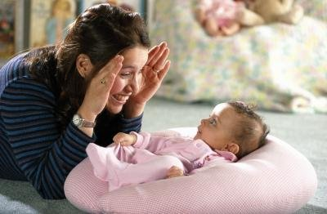
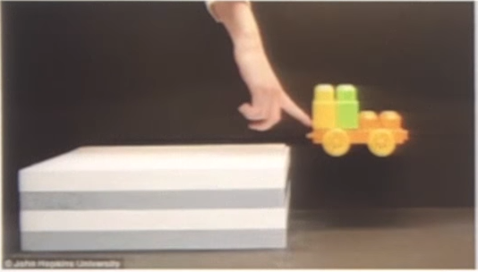
Examples and experience …
Humans learn by observation and (mostly) unsupervised learning
model of the world / common sense reasoning
Machines need a lot of training data to compensate
Important question in ML: what kind of data do we have, how much?

Slide 5
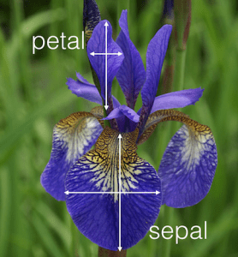

Data in machine learning
Most machine learning algorithms expect its input data to be numerical, typically in matrix (tabular) format
Design matrix
N samples: each row is a different data item
D features: each column is a different feature
Example: Iris flower dataset, N=150, D=4 http://archive.ics.uci.edu/ml/datasets/Iris
Sepal length | Sepal width | Petal length | Petal width
5.1 | 3.5 | 1.4 | 0.2
4.9 | 3.0 | 1.4 | 0.2
4.7 | 3.2 | 1.3 | 0.2
4.6 | 3.1 | 1.5 | 0.2
5.0 | 3.6 | 1.4 | 0.3
5.4 | 3.9 | 1.7 | 0.4
4.6 | 3.4 | 1.4 | 0.3
5.0 | 3.4 | 1.5 | 0.2
4.4 | 2.9 | 1.4 | 0.2
one row = one specific flower.

Slide 6
Types of machine learning
Machine learning algorithms can be divided into different types based on the sorts of tasks we are trying to solve
Machine learning
Supervised learning
Unsupervised learning
Reinforcement learning
Classification
Regression
Detection
Clustering
Anomaly detection
Association rules

Slide 7
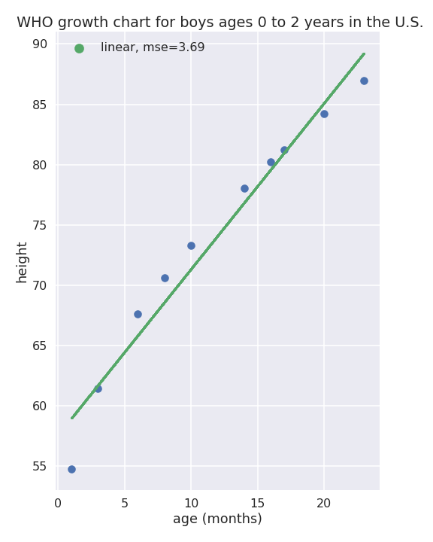

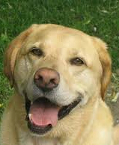
Supervised learning
Each data item x also has an associated label or target y
We try to learn or model a connection between x and y
y
model ?
X
y
cat
X
If y is a real value → regression
dog
if y is a class (category) → classification.
X
y

Slide 8
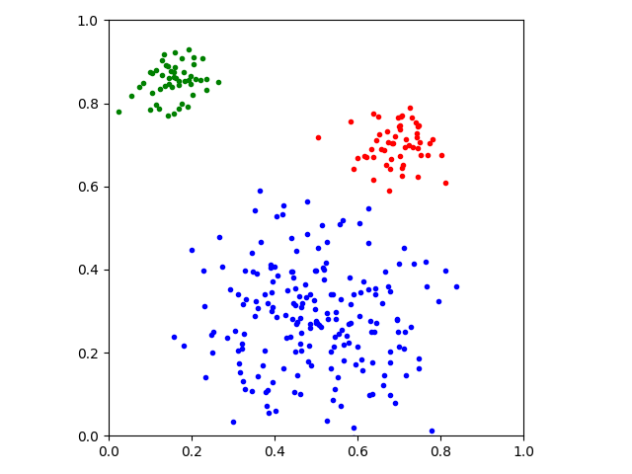
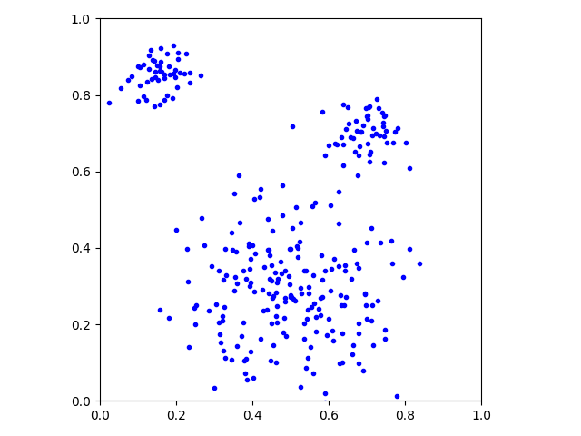
Unsupervised learning
We only have data items x, no labels are given
We can still do some useful things, e.g.:
Clustering
Anomaly detection
Association rules

Slide 9
Models, training and inference

Slide 10
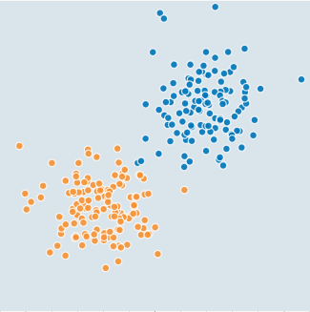
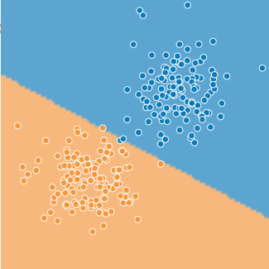
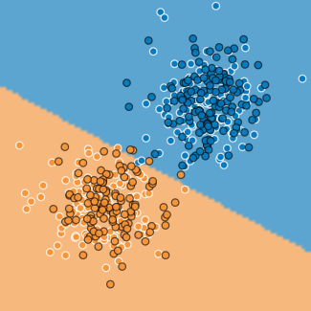
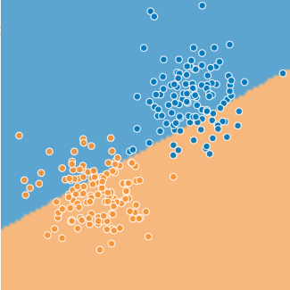
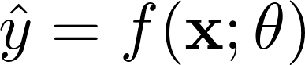
Model, training and inference
Example: we want to classify some data into two classes
Select the type of model to map inputs x to outputs y
We train the model: find good values for the parameters 𝜃
Inference: new data points can now be classified, keeping the parameters fixed.
Images generated with http://playground.tensorflow.org/

Slide 11
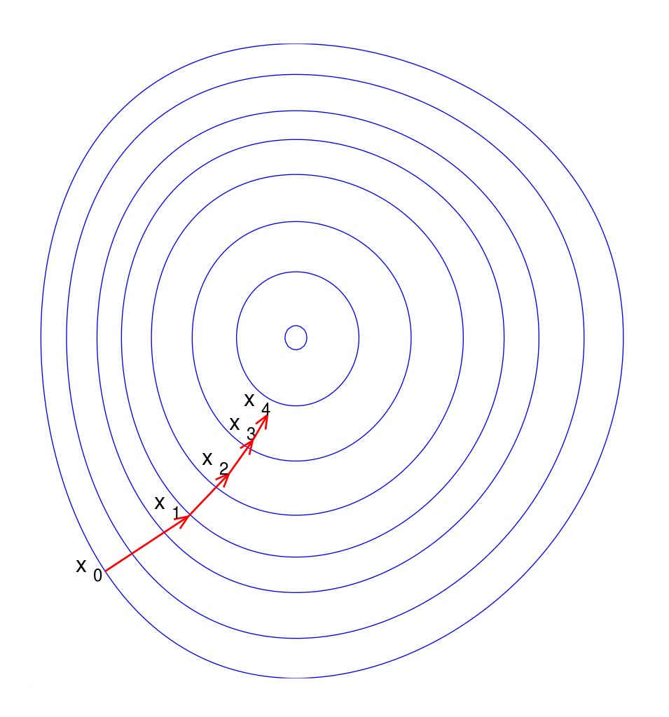
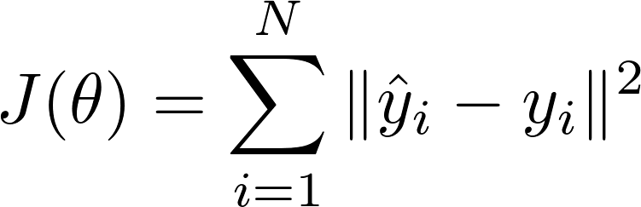
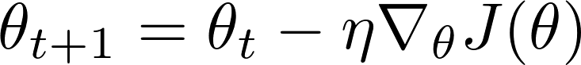
How do we find the optimal parameters 𝜃?
In some cases we can do it by directly solving the equations
In some cases we have to use an iterative optimization approach, for example Gradient descent (GD):
Define a cost function, e.g.,
Start with some (typically random) values for the parameters 𝜃
Take small steps towards the direction that decreases the cost (according to gradient)
learning rate = size of steps
In general, not guaranteed to find the optimal solution …

Slide 12
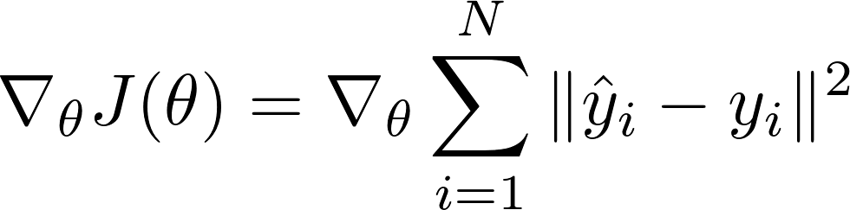
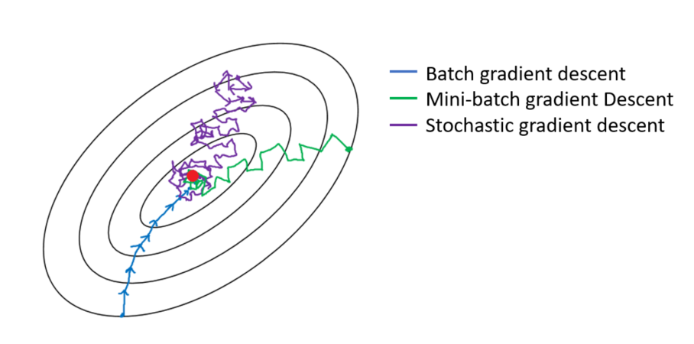
Stochastic gradient descent
Evaluating (the gradient of) the cost function requires summing over the whole dataset
Costly for big datasets!
Solution: stochastic gradient descent (SGD)
Update for each sample, not the whole dataset
In practice, a compromise: update in minibatches.

Slide 13
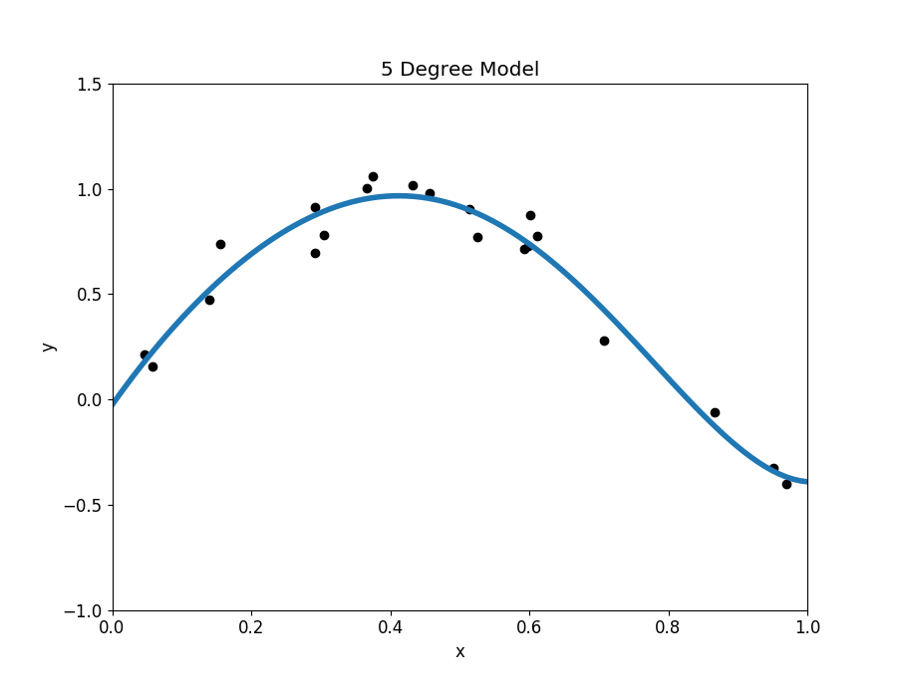
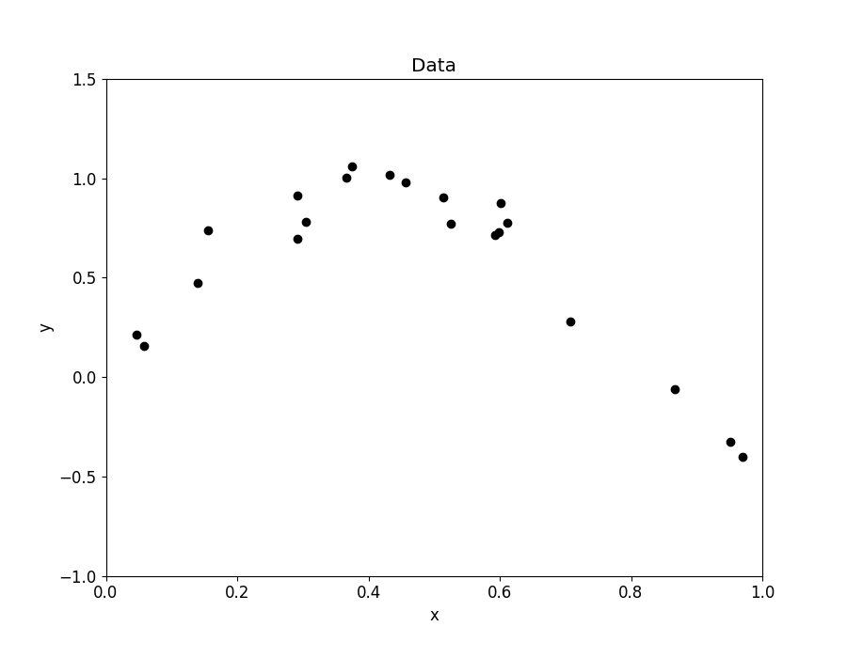
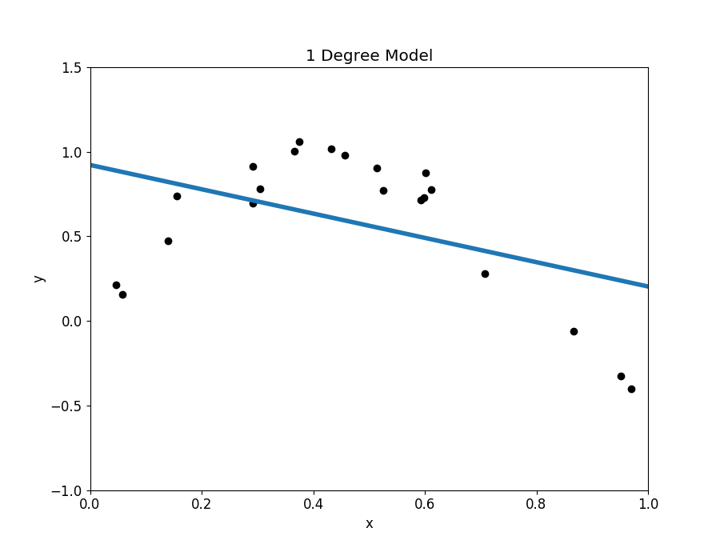
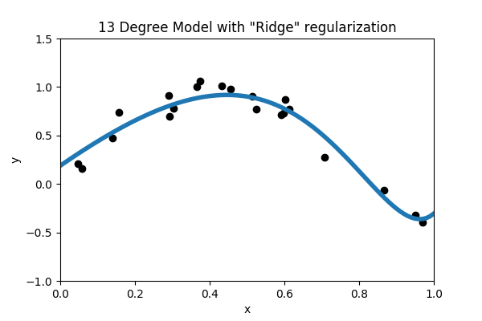
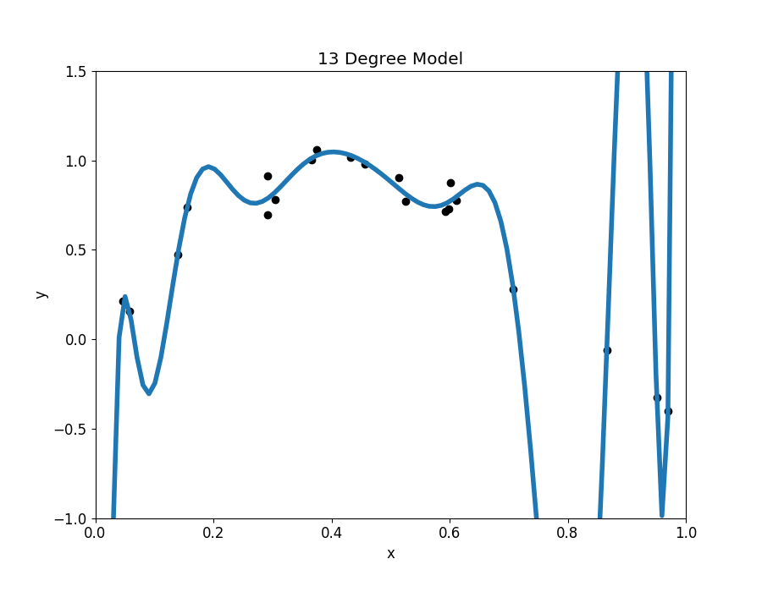
Over- and underfitting, regularization
A model that is too simple will underfit
Models with lots of parameters can easily overfit to training data
Regularization: any method* to prevent overfitting
simplicity, sparsity, dropout, early stopping
*) other than adding more data
.
Images adapted from https://towardsdatascience.com/overfitting-vs-underfitting-a-complete-example-d05dd7e19765

Slide 14
Training, validation and testing
Training data
Validation
Test
Don’t trust your performance measure on the training set!
A complex enough model could memorize each training sample and get a perfect score!
The true test is how it performs on new data it has never seen
For this we need a test set (separate from the training set)
Generalization: how well the model performs on the test set
Typically you will go back and forth, try different models and hyperparameters (configurations of the model other than 𝜃)
Problem: You will start to optimize against the test set
Solution: have a validation set for model development, and use the test set only at the very end.

Slide 15
Supervised machine learning workflow
Test data
Validation data
Input data
Data cleaning
Train data
Train model
Validate model
Test model
Deploy model
More realistic estimate of generalization
Adjust hyper-parameters

Slide 16
Classification

Slide 17
Classification: output is categorical
Machine learning
Supervised learning
Unsupervised learning
Reinforcement learning
Examples:
predict if an image depicts a cat or a dog
predict car type based on price and engine size
assign a category such as politics, business, sports to a text document based on its text contents.
Classification
Regression
Detection
Clustering
Anomaly detection
Association rules

Slide 18
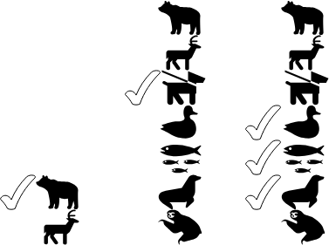
Binary, multi-class and multi-label
Types of classification
Binary: predict one out of two possible classes
Multi-class: predict one out of multiple (>2) classes
Multi-label: predict any out of multiple classes (or labels)
(note: output can also be zero.)
binary
multi-class
multi-label

Slide 19

Example: MNIST - handwritten digits
MNIST database of 70,000 images of handwritten digits
Ten classes: “0”, “1”, …, “9”
28x28 pixel gray scale images
“Hello, world” of machine learning
Task: given a 28x28 image, say what number it represents
In ML terms: multi-class classification problem with 10 classes
x = the 28x28 image, such as (expressed as a matrix of pixel values) y = the correct class, such as “3”
Learn a function to map x to y.

Slide 20

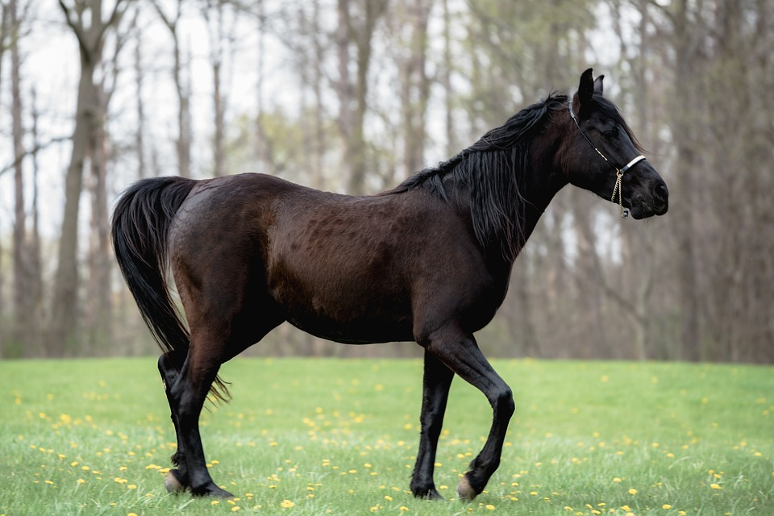

Performance measures: binary classification
Given a predicted class and the true class, there are four cases
Example: detect if the image contains a cat or not:
System prediction | Prediction type
cat | true positive
cat | false positive
not cat | true negative
not cat | false negative
Images from Wikipedia

Slide 21
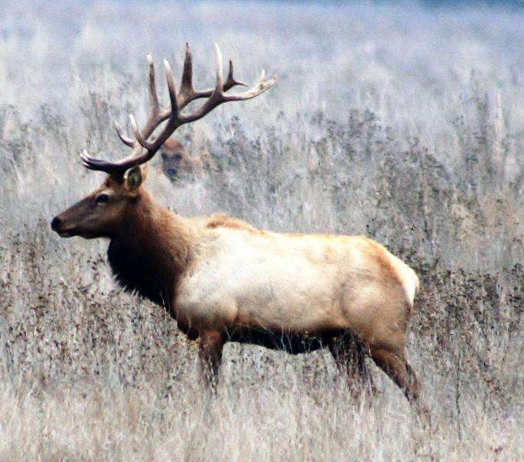



Accuracy, precision and recall
System prediction
cat | TP
cat | FP
not cat | TN
not cat | TN
not cat | FN
cat | TP
not cat | TN
not cat | FN
Accuracy = percentage of correct classifications = (TP + TN) / ALL
Precision = percentage of positive-predicted ones that were in fact positive = TP / (TP + FP)
Recall = percentage of all positive ones which were found = TP / (TP + FN)
= (2 + 3) / 8 = 0,625
= 2 / (2 + 1) = 0,66
= 2 / (2 + 2) = 0,5
Example: TP = 2, TN = 3, FP = 1, FN = 2
Images from Wikipedia

Slide 22
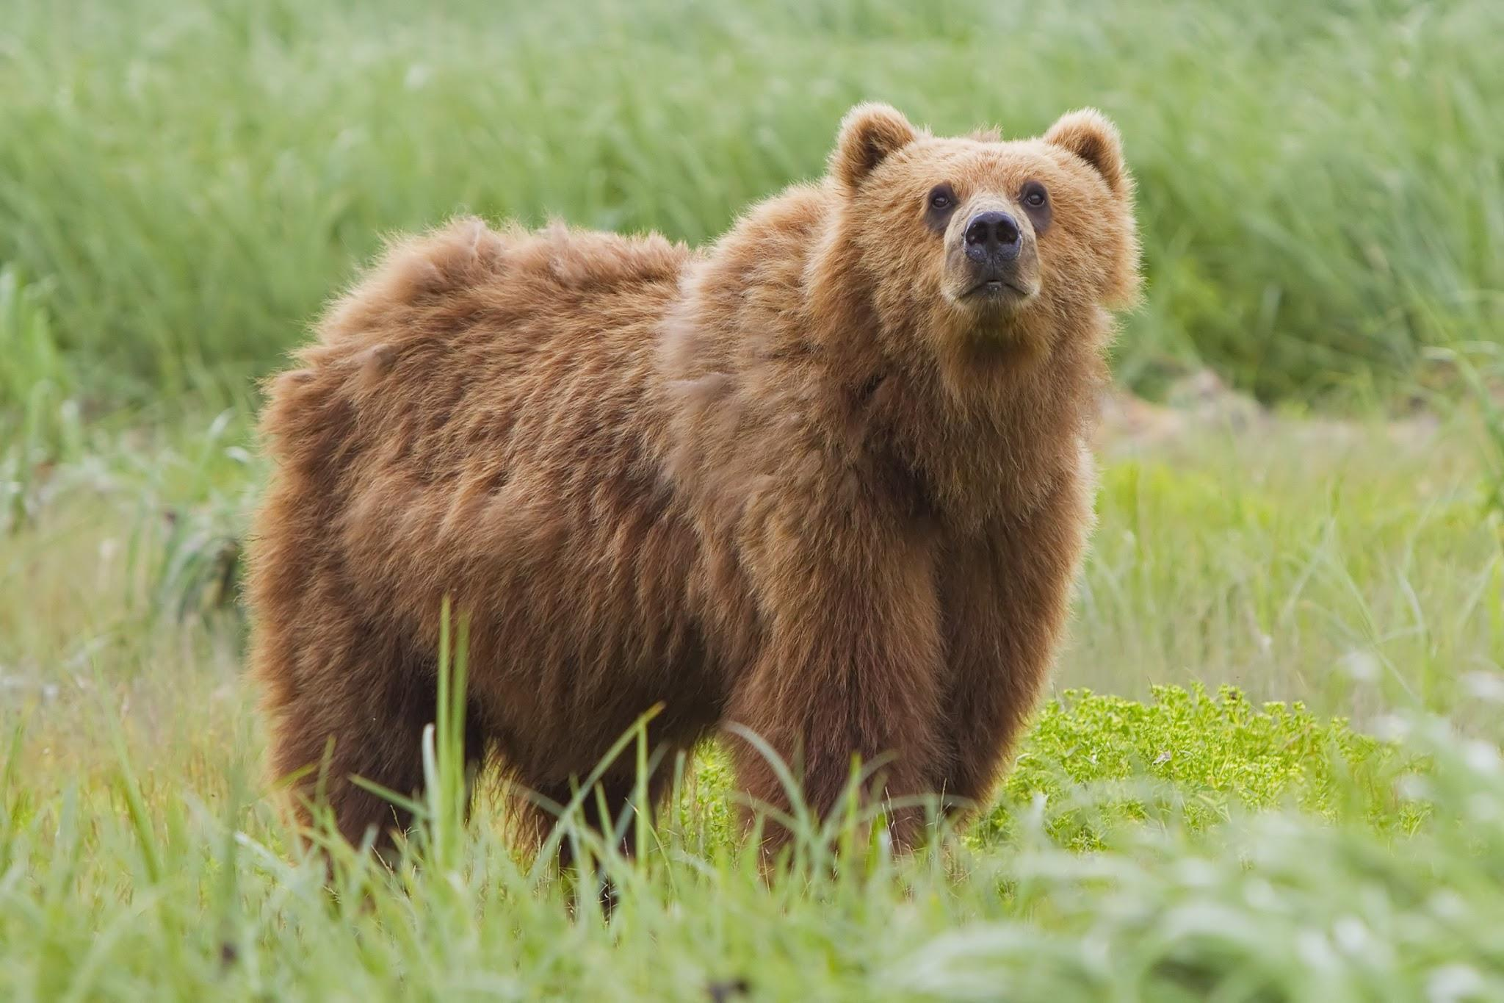
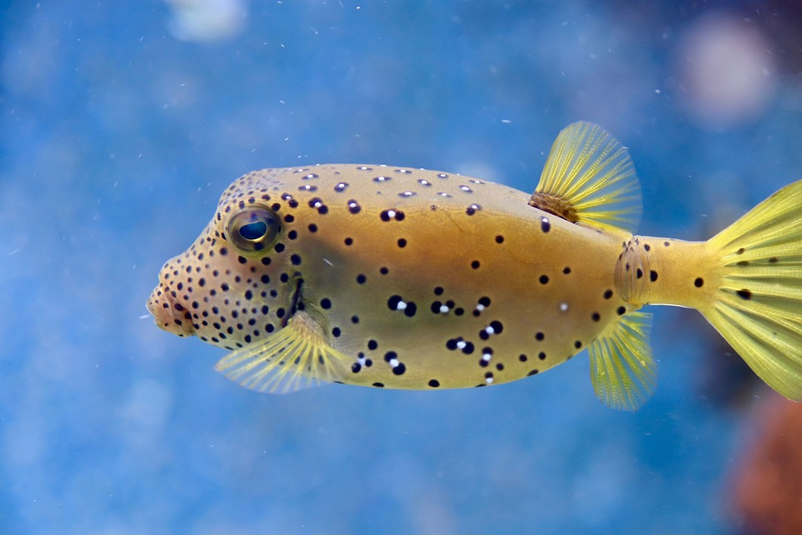

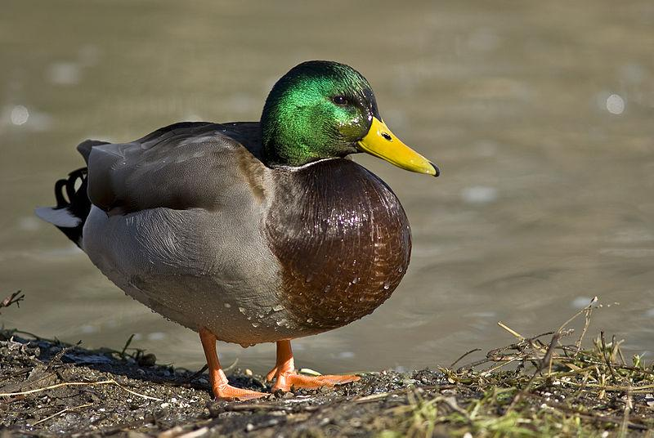
Example: rare true class
System prediction
cat | TP
cat | FP
not cat | TN
not cat | TN
not cat | TN
not cat | TN
not cat | TN
not cat | TN
Accuracy = percentage of correct classifications = (TP + TN) / ALL
Precision = percentage of positive-predicted ones were in fact positive = TP / (TP + FP)
Recall = percentage of all positive ones which were found = TP / (TP + FN)
= (1 +6) / 8 = 0,875
= 1 / (1 + 1) = 0,5
= 1 / (1 + 0) = 1
Example: TP = 1, TN = 6, FP = 1, FN = 0
Images from Wikipedia

Slide 23
Example: dummy classifier
System prediction
not cat | FN
not cat | TN
not cat | TN
not cat | TN
not cat | TN
not cat | TN
not cat | TN
not cat | TN
Accuracy = percentage of correct classifications = (TP + TN) / ALL
Precision = percentage of positive-predicted ones were in fact positive = TP / (TP + FP)
Recall = percentage of all positive ones which were found = TP / (TP + FN)
= (0 + 7) / 8 = 0,875
= 0 / (0 + 0) ≃ 0
= 0 / (0 + 1) = 0
Example: TP = 0, TN = 7, FP = 0, FN = 1
Images from Wikipedia

Slide 24
Performance measures: multi-class
Accuracy = percentage of correct classifications
Precision and recall only make sense class-wise (as one-versus-rest)
Confusion matrix: rows = true classes, columns = predicted classes
Makes it easy to analyse problems
Example: system has problem distinguishing cats and dogs, but rabbits are easy
 |  | Predicted class
 |  | Cat | Dog | Rabbit
Actual class | Cat | 5 | 2 | 0
 | Dog | 3 | 3 | 2
 | Rabbit | 0 | 1 | 11
Example from Wikipedia

Slide 25
Regression

Slide 26
Regression: output is numerical
Machine learning
Supervised learning
Unsupervised learning
Reinforcement learning
Examples:
predict weight based on height
predict credit risk based on bank account information
predict money spent on a freemium game based on available data
predict house prices based on location and other available data
Classification
Regression
Detection
Clustering
Anomaly detection
Association rules

Slide 27
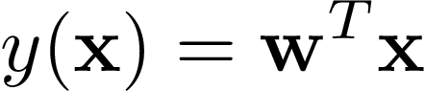
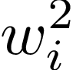
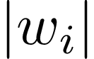
Linear regression
The simplest regression model
The output has a linear relationship to the input variables:
Can be solved in closed form (linear least squares) or e.g. by SGD.
Regularized variants:
Ridge regr.: constraint on
Lasso: constraint on
Elastic net: combination of both
Data from: https://www.cdc.gov/growthcharts/who/boys_length_weight.htm

Slide 28
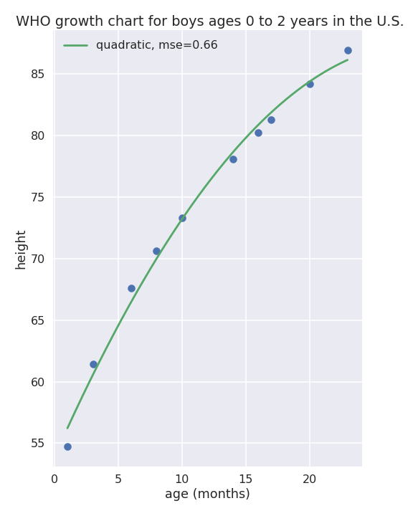

Nonlinear regression
What if the data is not linear?
One approach is to use higher-degree polynomials

Slide 29
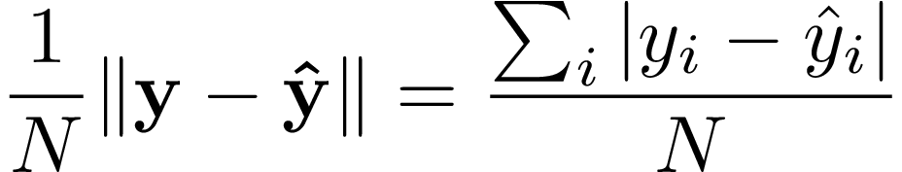
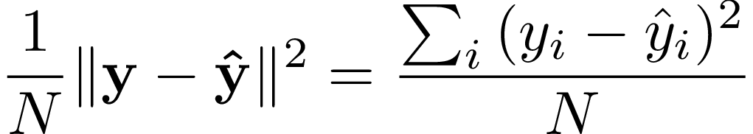
Performance measures for regression
Mean absolute error (MAE):
Mean squared error (MSE):
Also many others, like R², see ,e.g.,: https://scikit-learn.org/stable/modules/model_evaluation.html#regression-metrics

Slide 30
Clustering

Slide 31
Unsupervised learning
Machine learning
We only have data items x, no labels are given
Learning a model to describe hidden structure in unlabeled data.
Supervised learning
Unsupervised learning
Reinforcement learning
Classification
Regression
Detection
Clustering
Anomaly detection
Association rules

Slide 32
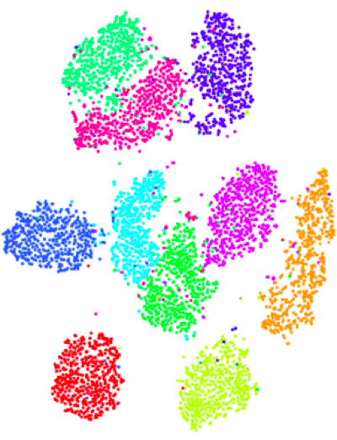
Clustering
Grouping a dataset so that samples in the same group (cluster) are more similar to each other than to those in other groups (clusters)
Lots of algorithms: • k-means • hierarchical clustering • Gaussian mixture model • DBSCAN, OPTICS • biclustering • spectral clustering, etc.

Slide 33
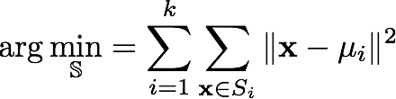
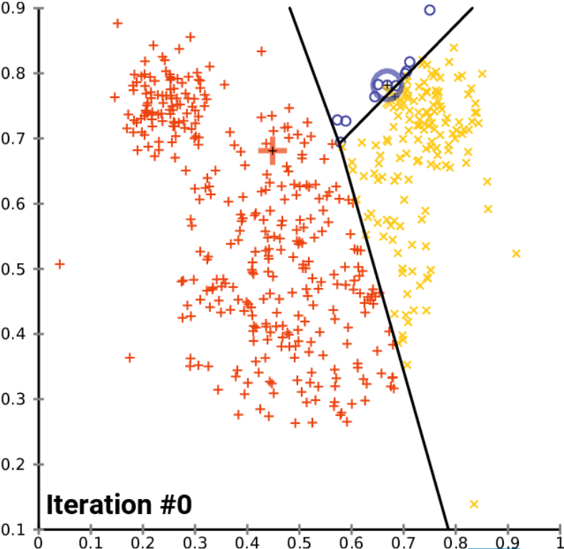

k-means
Clusters data by trying to separate samples in k groups of equal variance, minimizing within-cluster sum-of-squares:
Each cluster has a centroid 𝝁_{i}
User needs to specify the number of clusters k
Calculated using an iterative two-step algorithm

Slide 34
Some geospatial examples

Slide 35
Example geospatial regression problems
Estimate tree age based on other features, eg soil, meteorological factors, species, stand attributes , …
Estimate amount of algae based on meteorological factors, water depth, season, ….
Estimate housing prices based on location of services, …
Estimate income for zip code based on location, demographic data,...

Slide 36
Example geospatial classification problems
Tree/crop species classification based on pointcloud, image data
Land cover classification based on spaceborne multispectral data -> Exercise

Slide 37
Example geospatial clustering problems
Cloud detection
…

Slide 38
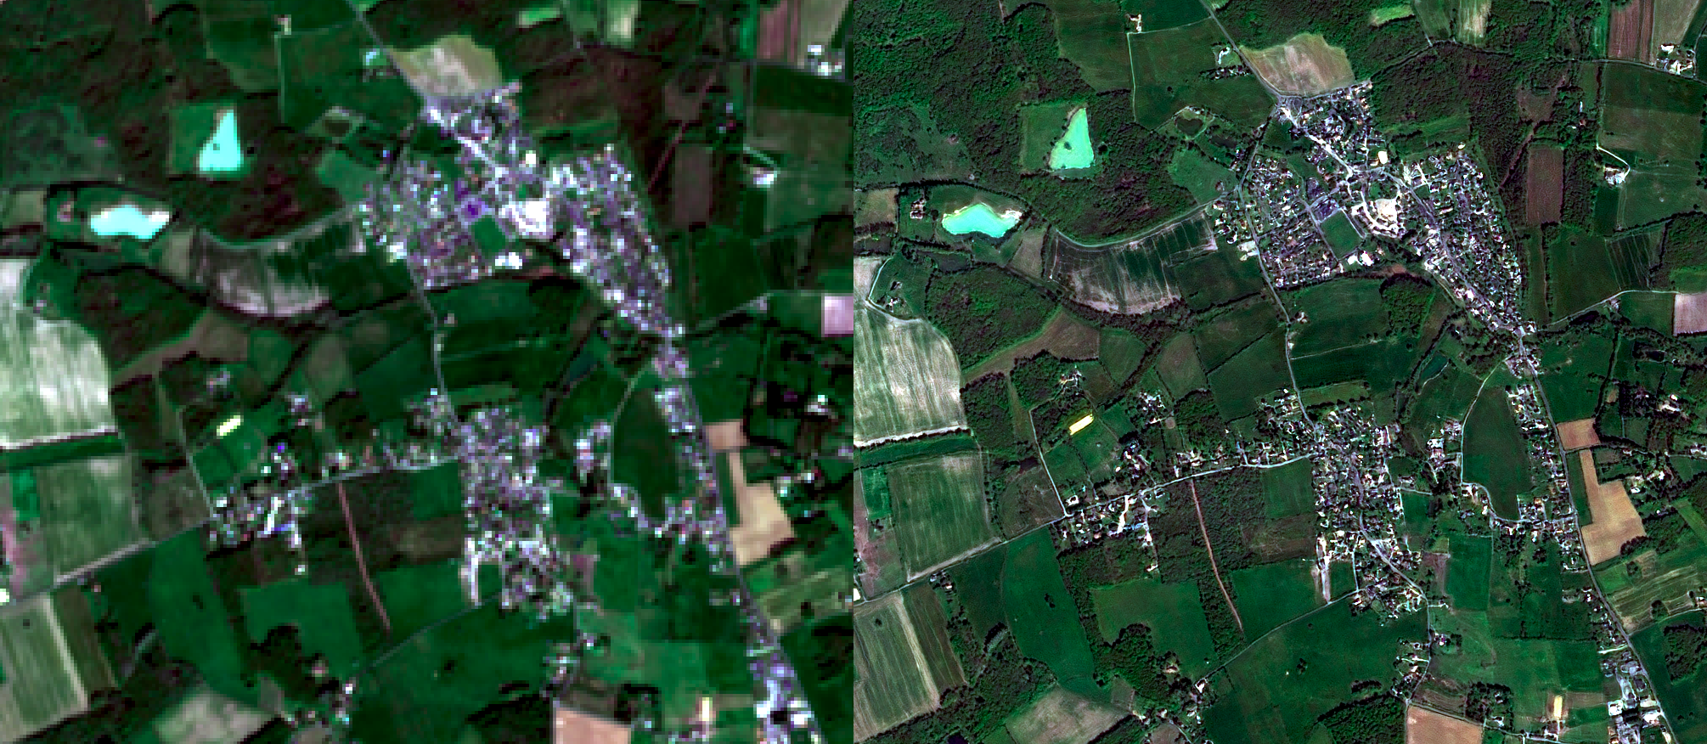
Super-resolution (model training on higher resolution data)
https://github.com/remicres/sr4rs

Slide 39
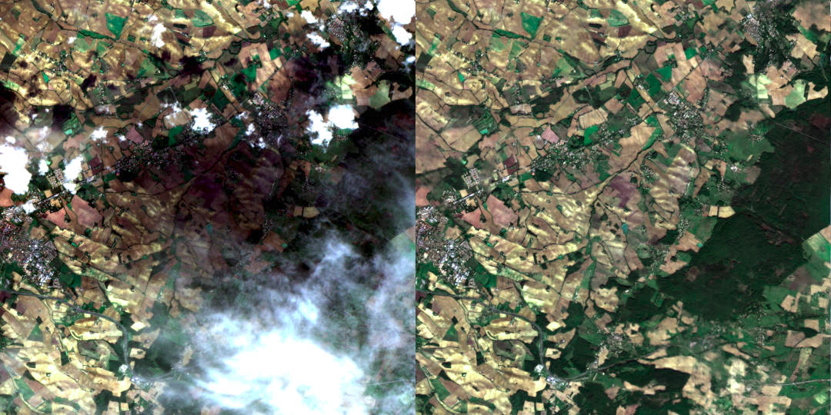
Decloud (use RADAR to fill optical datas gaps)
https://github.com/CNES/decloud

Slide 40
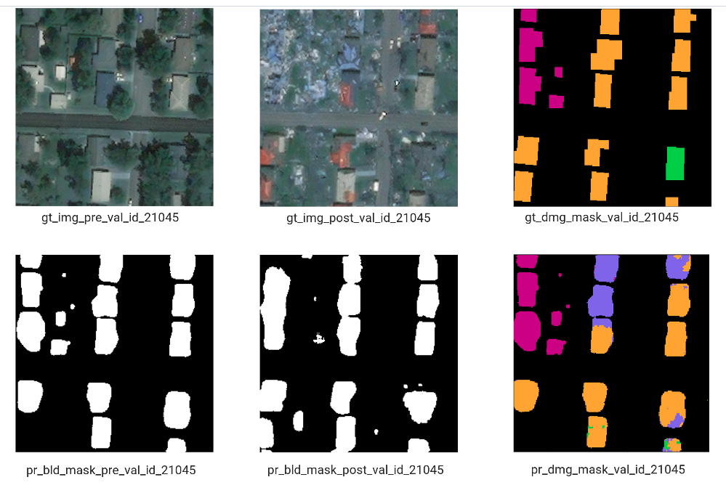
Building damage assessment
https://github.com/microsoft/building-damage-assessment-cnn-siamese

Slide 41
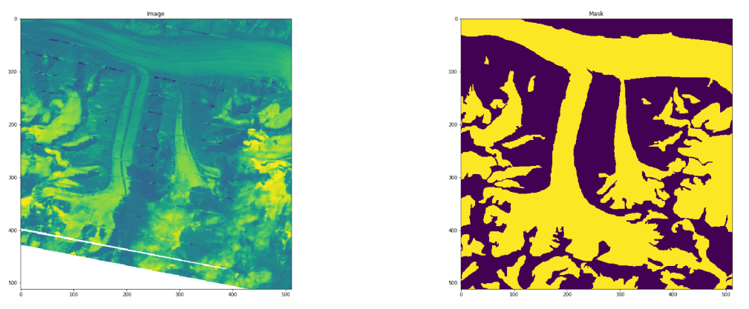
Glacier mapping
Data: multispectral spaceborne
https://github.com/krisrs1128/glacier_mapping

Slide 42
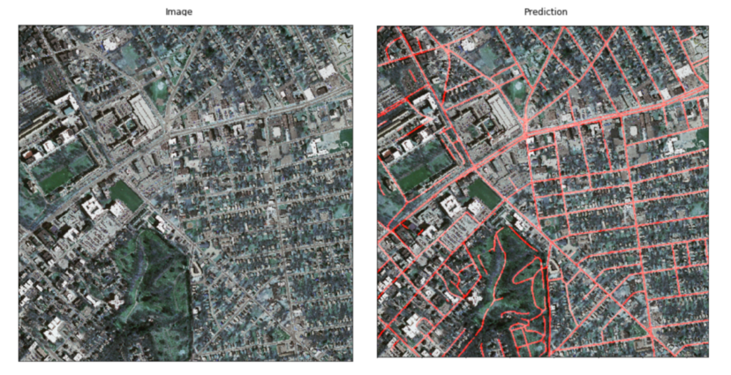
Roads identification, CNN
Jerin Paul, Segmentation of Roads in Aerial Images, https://towardsdatascience.com/road-segmentation-727fb41c51af

Slide 43
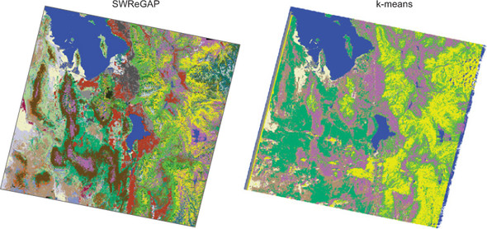
An unsupervised classification algorithm used for classification of land cover in Utah-US using Landsat images.
Project named SWReGAP done in USA (https://swregap.org/)

Slide 44
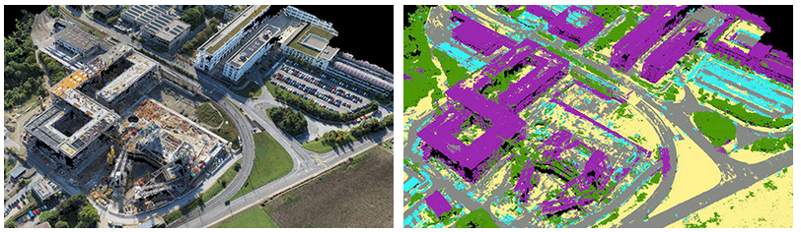
Machine learning in classification of point clouds generated by drones.
Image by pix4d.com
https://www.pix4d.com/blog/construction-surveys-point-cloud-classification
Notes:
https://www.pix4d.com/blog/construction-surveys-point-cloud-classification

Slide 45

Exercise
Automate Building Footprint Extraction using Deep learning
https://www.arcgis.com/home/item.html?id=342919a470044ddaac8a299820a51204

